Slide 1


Providing a Safe Place to Work
Protecting your People, Customers and Visitors
February 2021

Slide 2


Confidentiality Statement
The reader of this document hereby acknowledges that the information provided is completely confidential and therefore the reader agrees not to disclose information from this document without the express written consent of iM8 Data Limited
It is also acknowledged by the reader that the information to be furnished in this document is in all aspects confidential in nature, other than information that is in the public domain through other means, and that any disclosure or use of the same by the reader may cause serious harm and or damage to iM8 Data Limited
Upon request this document will be immediately returned to iM8 Data Limited
All information contained in this document is © iM8 Data Limited

Slide 3


It started with a QR
code…
iM8 is a comprehensive app and blockchain based authentication, verification and compliance ecosystem

Slide 4

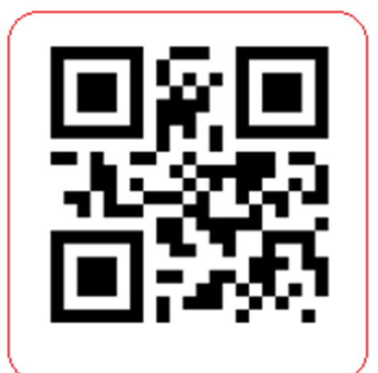
Blockchain Guaranteed
Traceability Authenticity & Compliance

Slide 5

Personal Health Blockchain (PHB)
Safe Masks
Safe Workplace
Safe Tests

Slide 6
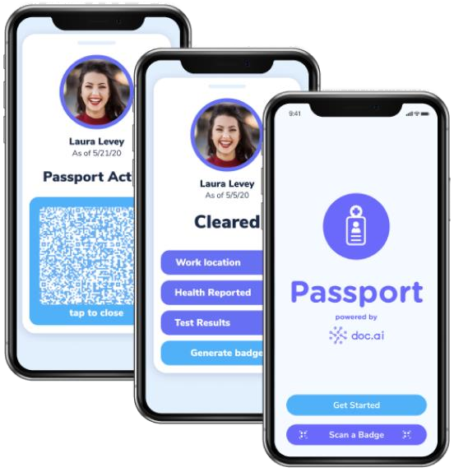

What is a PHB?
An app based ecosystem which maintains a
record of personal sanitisation events and tasks
Each time a new mask is used, a Covid test is performed or any related event, a record is logged to the iM8 Blockchain
Details of these events are shared (as appropriate) with the employer
For instance, records of mask usage, workplace tests
The employee status is recorded on the iM8 H&S Dashboard

Slide 7

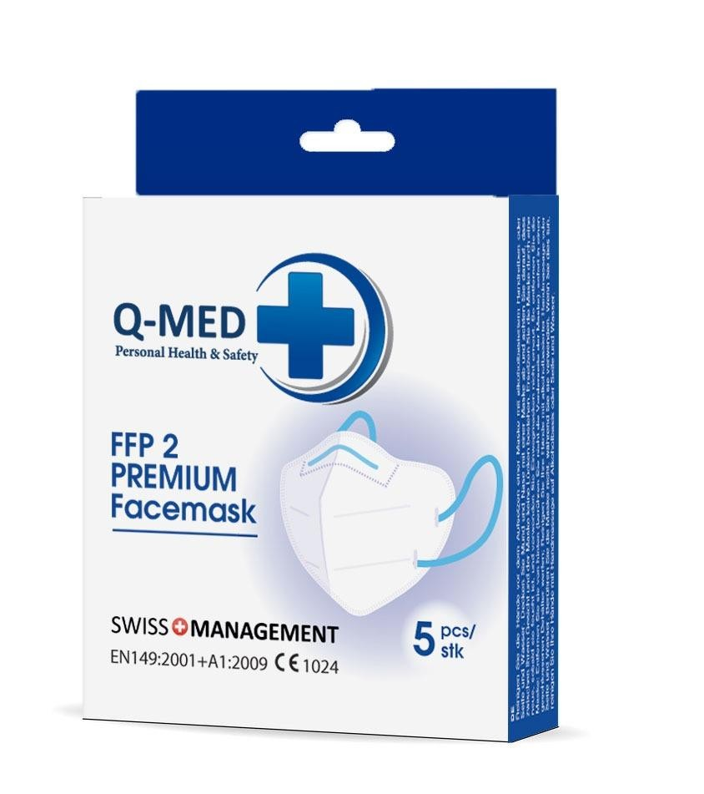
Safe Masks
Employees and visitors are issued with single use masks
The employee scans the mask using their PHB app
The Blockchain records the use of the mask, the location and starts a timer
The app pings the employee when the usage time of the mask expires, at which point the employee scans and wears a new mask
Mask usage data is delivered to the employee compliance team and is displayed on the iM8 dashboard
Location information is utilized to link the employee, mask and location

Slide 8
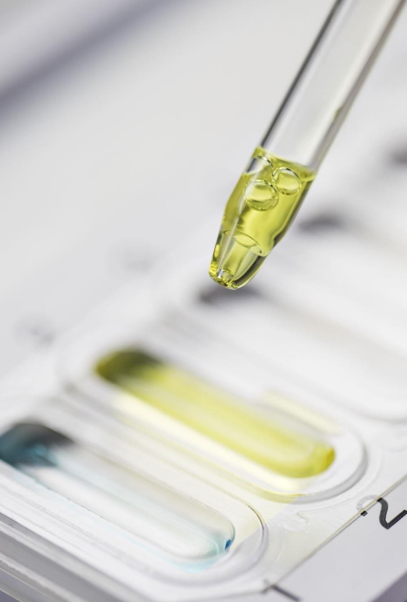
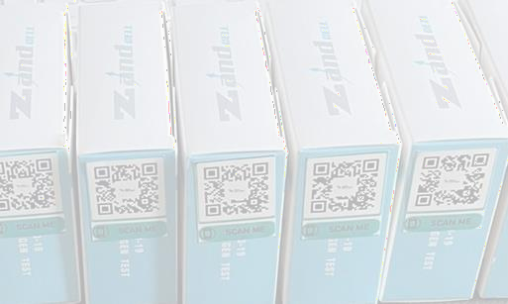
Safe Tests
The PHB user’s QR code and the Covid test kit
are both scanned by the testing technician
This links the user and the test kit in the iM8 Blockchain
The status of the test in automatically updated in the Blockchain with the test result
The test result is displayed in the users PHB app
The status of the user is displayed on the Company’s iM8 Dashboard and Compliance Portal

Slide 9
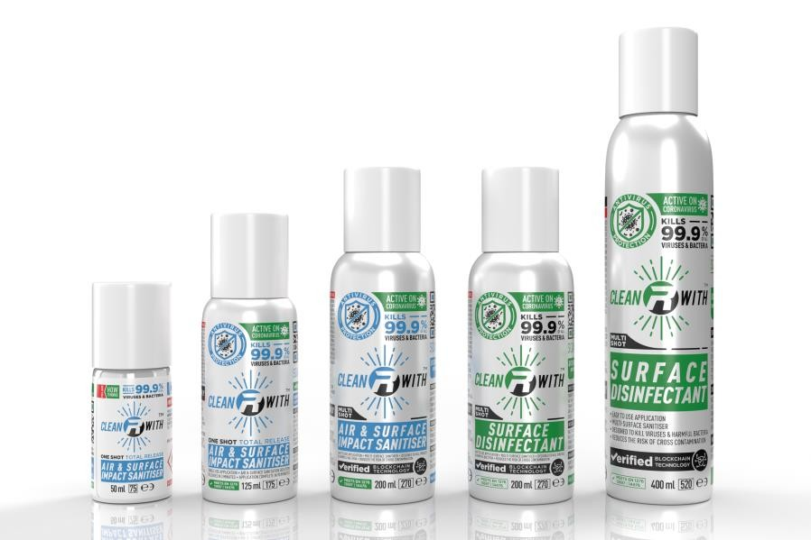

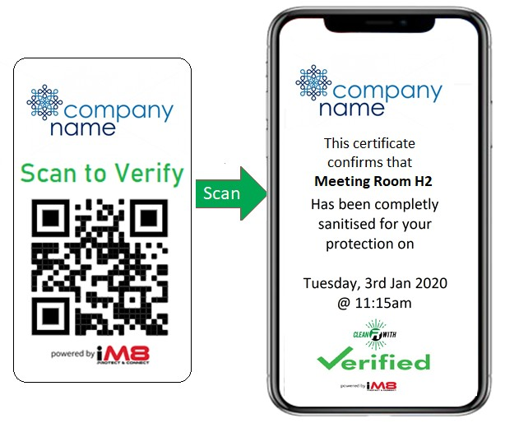
Safe Workplace
CleanRwith products are used to sanitise the office environments, delivering a Safe Place to Work to employees and visitors
The status of any workspace can be easily verified by an employee or visitor by scanning the QR code
The employee PHB is integrated with the
CleanRwith app, processes and dashboard

Slide 10

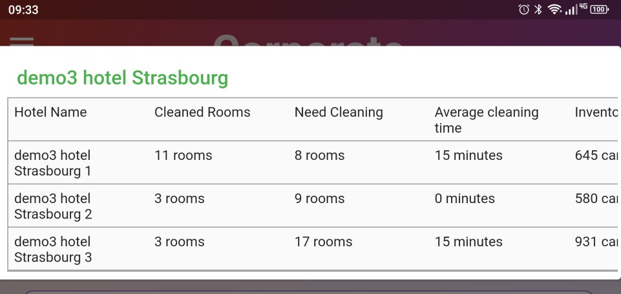
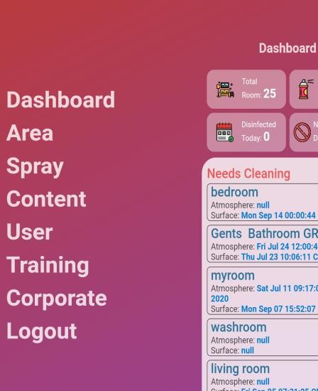
Safe Workplace
Corporate Health and Safety Reporting
KPI reporting
H&S Policy adherence
Sanitisation process analysis
Employee mask usage
Employee Covid test results
Available via the iM8 portal and App

Slide 11

The iM8 Blockchain
The iM8 Blockchain utilises the IBM Hyperledger Fabric Blockchain Ledger Architecture
This architecture is an open source platform created by IBM to encourage the use of Blockchain solution in businesses and to develop Blockchain technology for wider industry

Slide 12


© iM8 Data Limited 2020
All Rights Reserved
www.im8world.com

